Slide 1
Development of touch type Electric Gayageum for an experience-oriented exhibition
Team 9
Kyungpook National University – Computer Science and Engineering
2013105067 Lee Gyu Dong (leader)
2013105030 Gim Han Yeong
2011097084 Han Jae Hyun
Kumoh National Institute of Technolongy – Computer Science
20160437 Ma Jui
20160168 Kim Myeong Ji

Slide 2
Project Background and Purpose
Classical music instrument
Expensive
Difficult
Public Recognition
Change
To get close to the public.
Especially to be familiar with children.
Electronic Korean Instrument

Slide 3
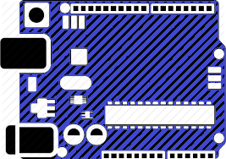

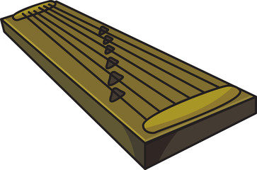
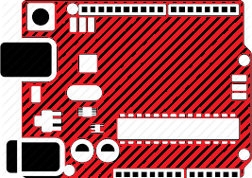


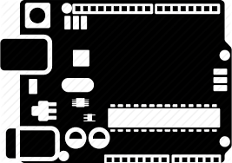

System Block Diagram

Slide 4

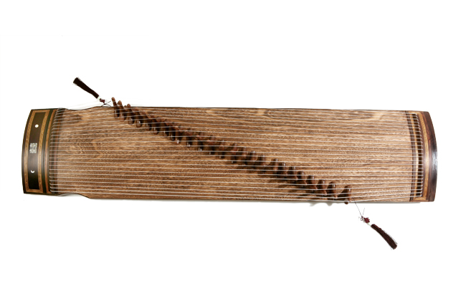
System Block Diagram
MAKE SOUND
TURN UP

Slide 5
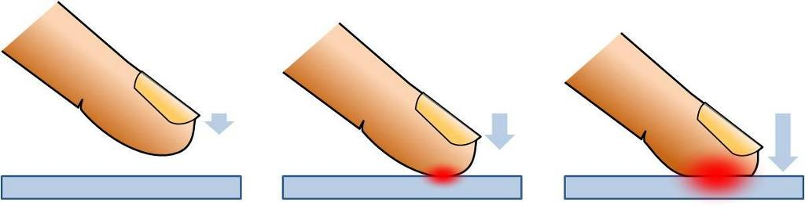
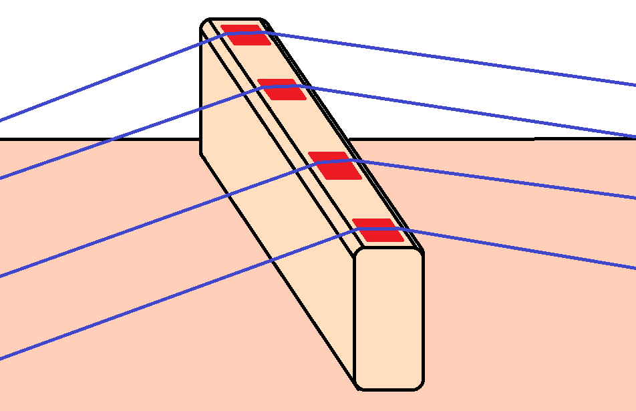
System Block Diagram

Slide 6
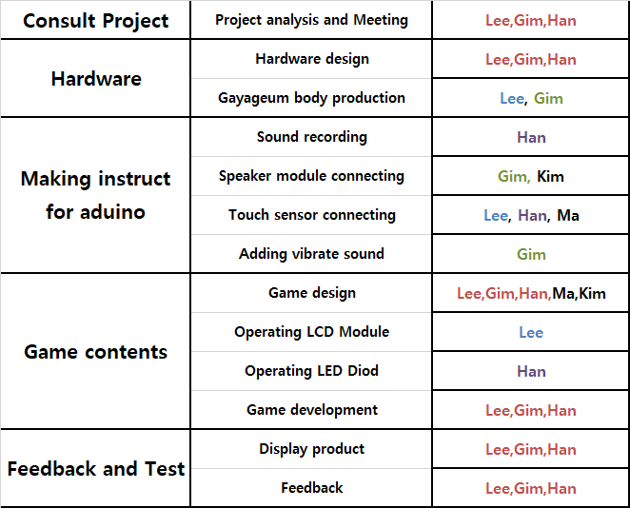
Project Distributing Roles

Slide 7
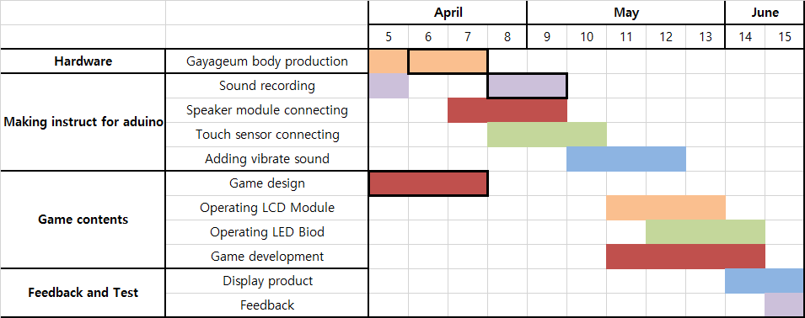
Project Schedule

Slide 8
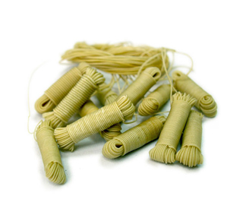
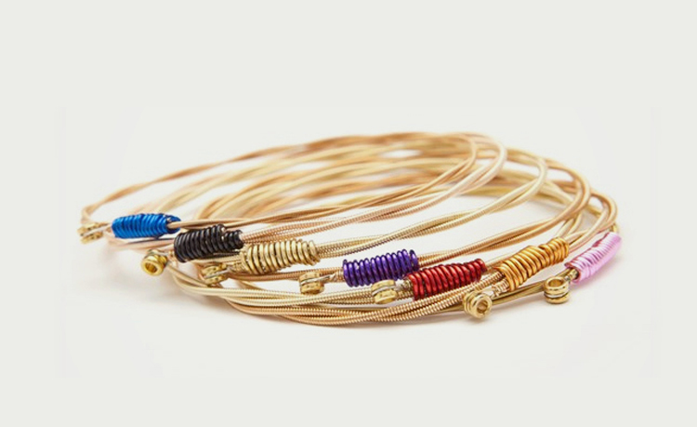
Problems
Need to change with
Electrically conductive object

Slide 9
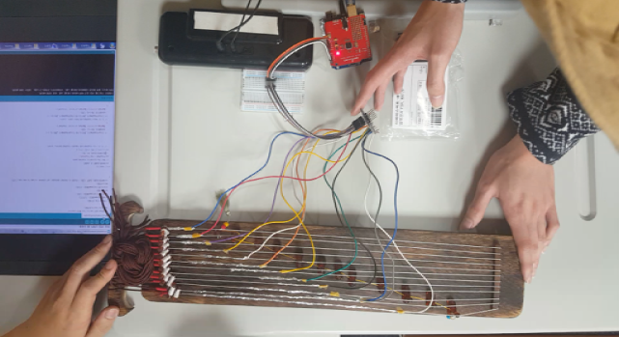
Problems
Make a storage space

Slide 10
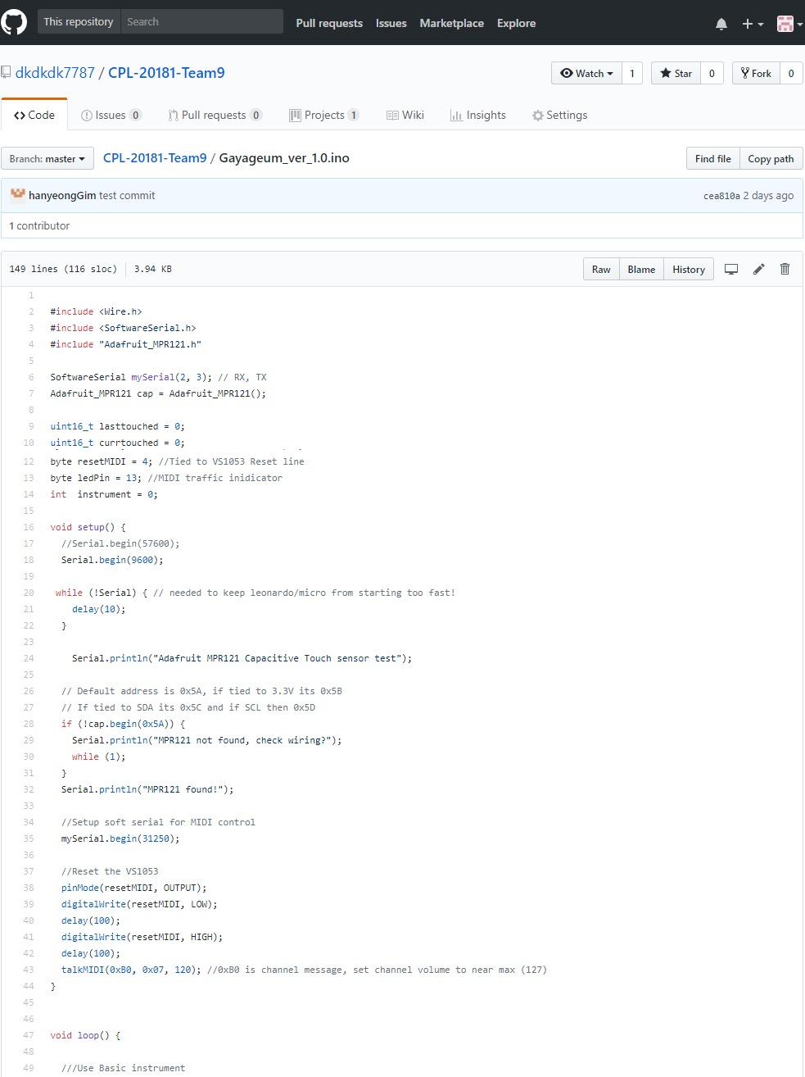
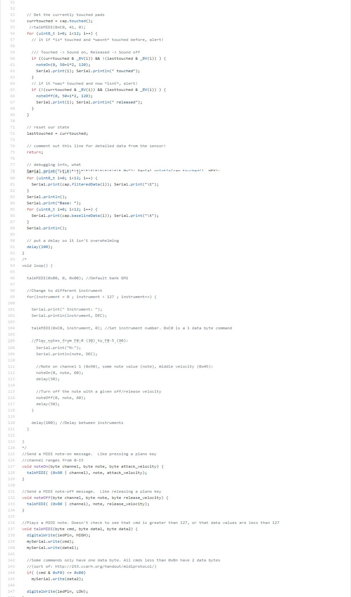

Slide 11
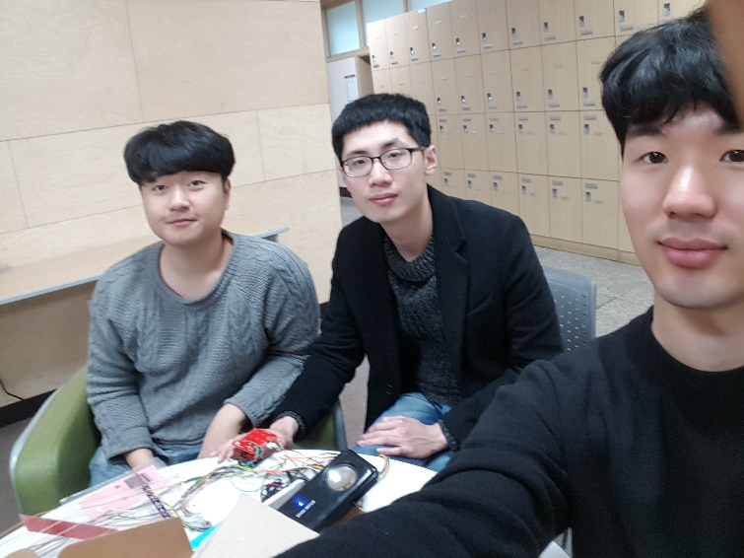
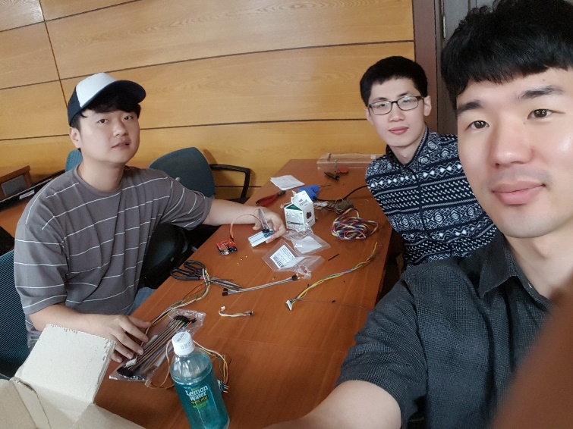
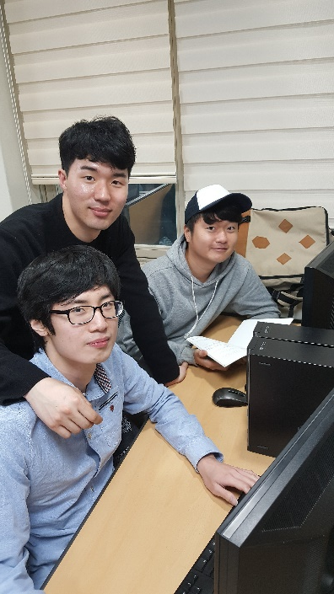
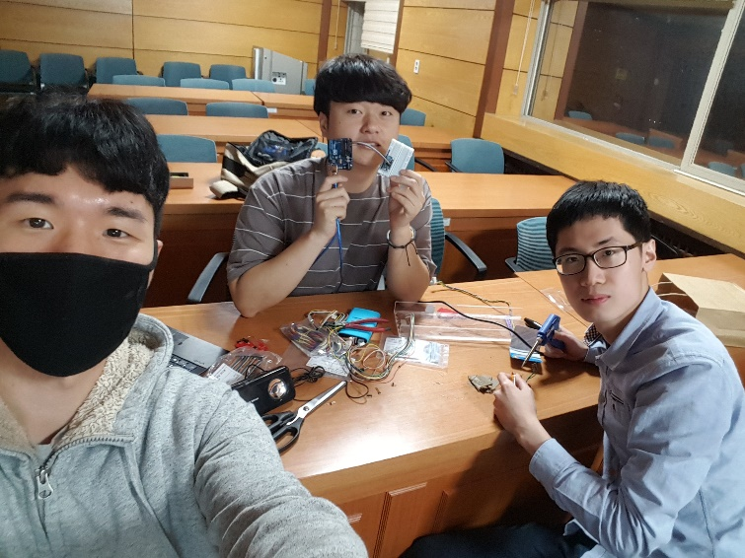
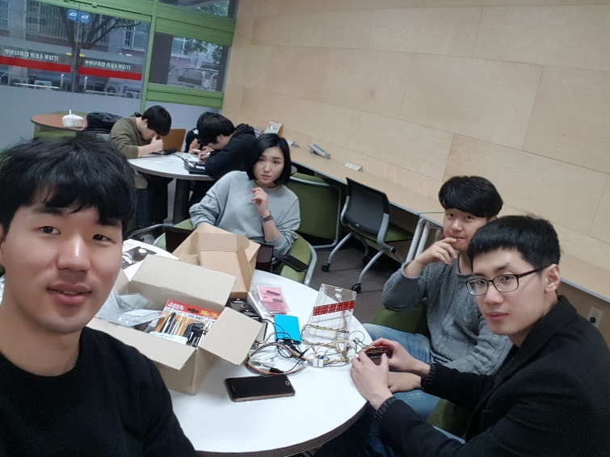
Meeting

Slide 12
Q&A
Thanks.

